Slide 1
Summer Training Project
Designing a responsive online music player

Slide 2



Our Team
Anurag Yadav
20BCS5427
Abhishek Verma
20BCS5439
Deepak Kumar
20BCS5391
Kartik
20BCS5421

Slide 3
Table of contents
01
02
03
About Project
Web Flow
Backend
What our project is based upon and also what are the requirements
Complete control flow to be explained
Brief the Backend communication part followed in the website

Slide 4
My Contribution
First of all I would like to tell how much my contribution in this project is: I have done the landing page in this project. In this page, we have given the navigation bar at the top in which the button of " Dive In " this is given in the right side corner. We have to click on this button to go to the home page. And "Sign In" button is given on the left side of the Dive In button. In the left-side middle of this page, there is a navigation menu, where we have given 5 buttons which are of Home, About, Services, Pricing and Contact. By clicking on all these buttons, we can go to different pages.

Slide 5
01
About Project
What our project is based upon and also what are the requirements

Slide 6
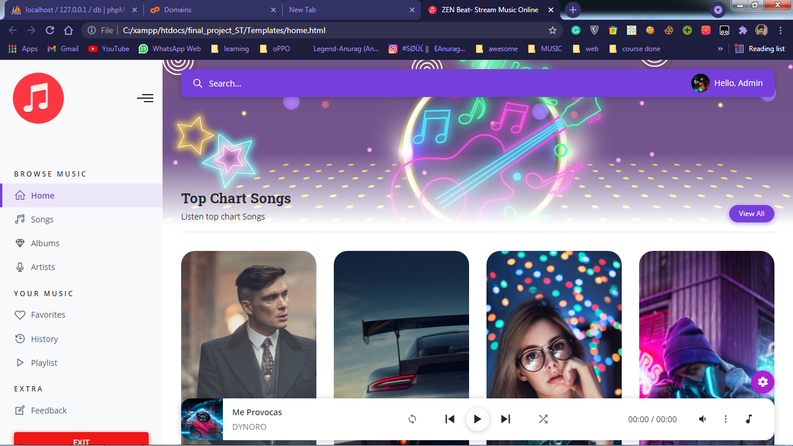
Introduction
The website is aimed to be responsive made that can play music online with controls.
What it offers:
Play music anytime
It’s your choice to register or not!
Collecting of user data
Various songs and various artists
Audio planel to control the music

Slide 7


What are the requirement?
HTML
CSS
Jupiter
PHP
To Define the structure
To Beautify the layout
To add dynamic Behaviour to web pages
Connecting the user to database at the back end

Slide 8
02
Web Flow
Complete control flow to be explained with timeline

Slide 9
Website Flow
Main Homepage
Explore
Songs, Artists
Landing Page
LogOut/ Exit
Sign In/
Sign Up
Start Playing music

Slide 10
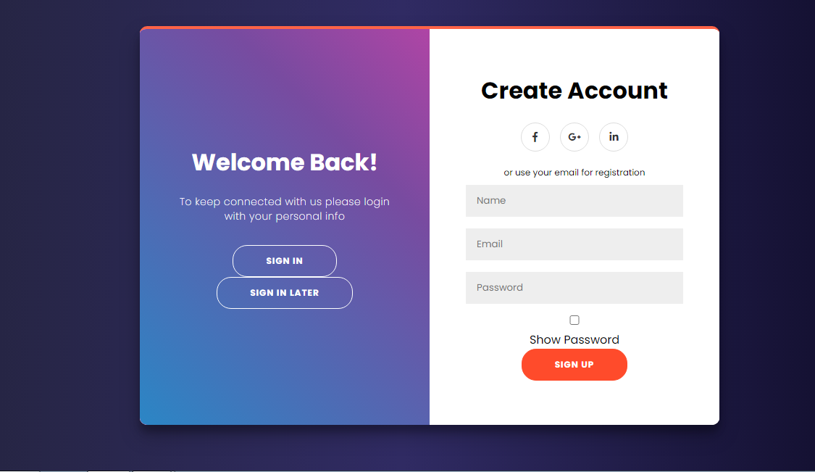
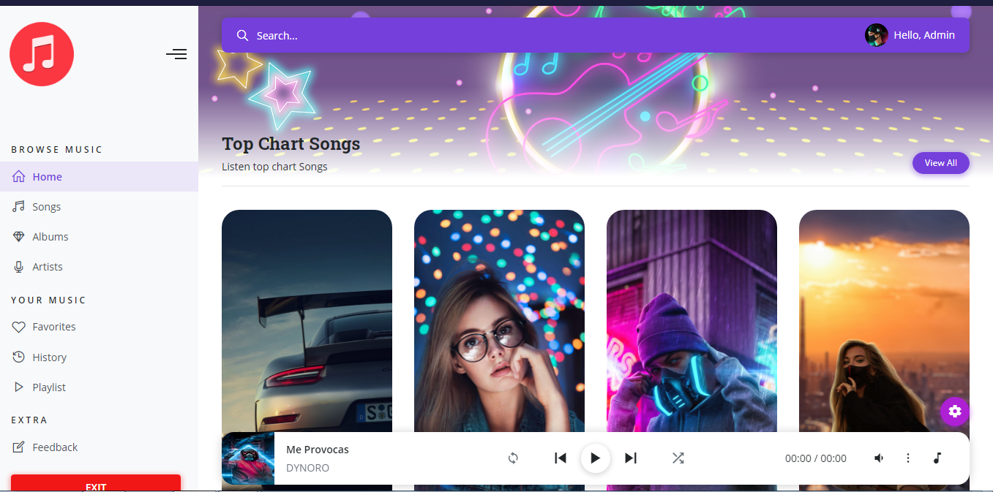
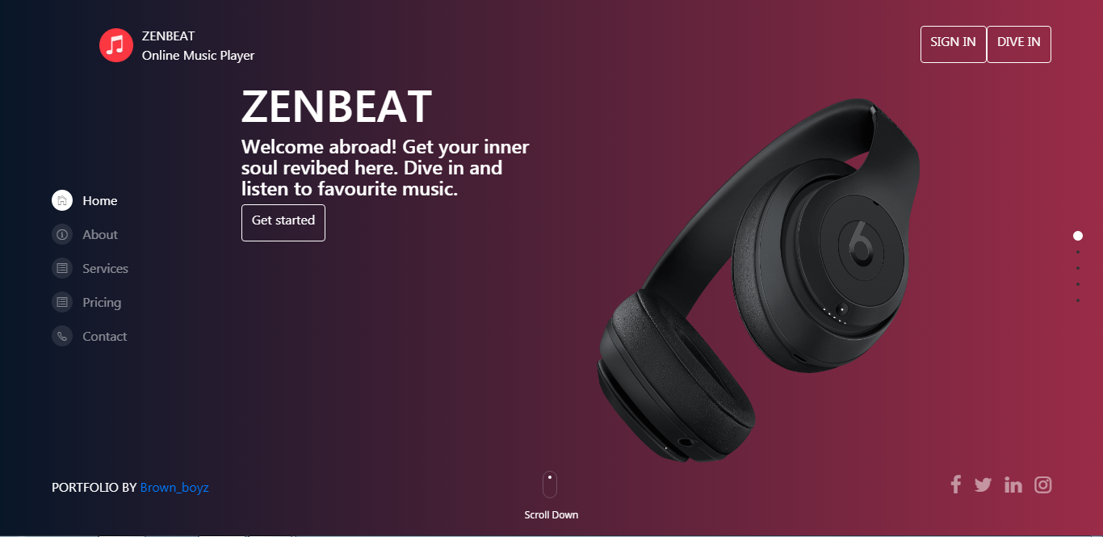
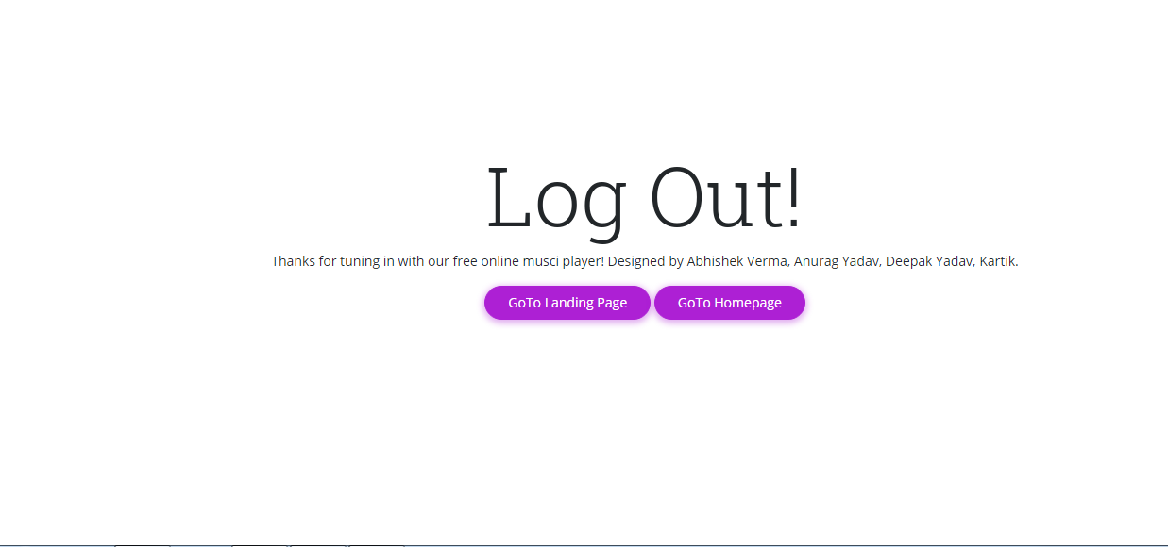
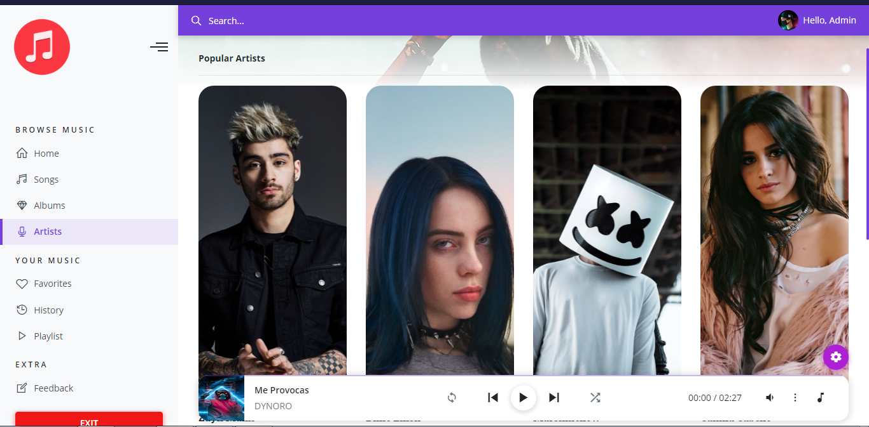
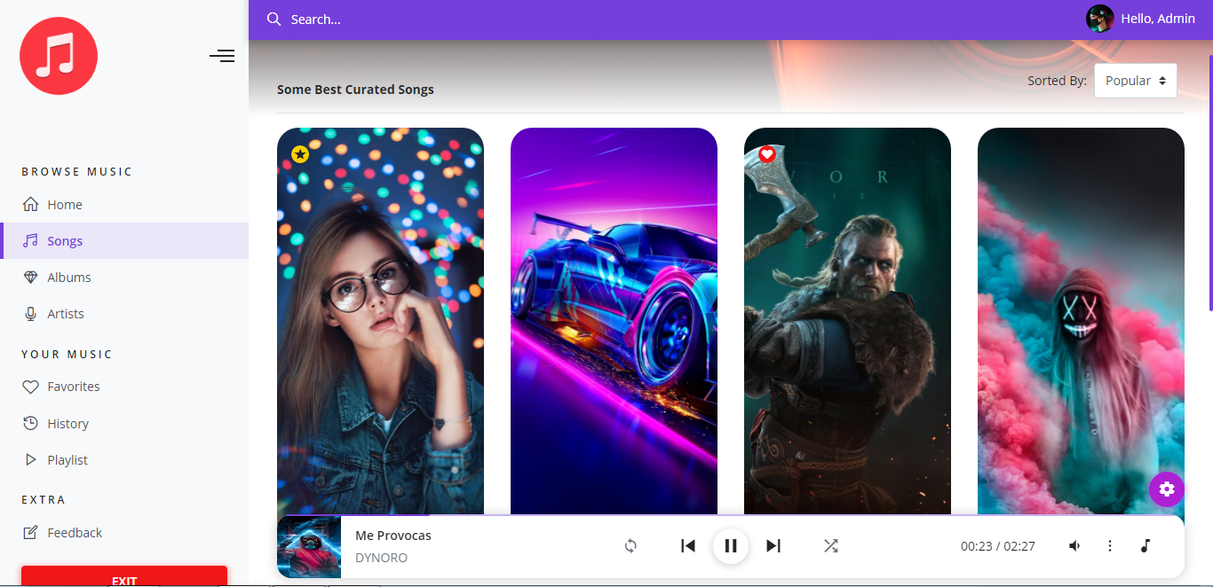
Web Page Flow
Landing Page
Home Page
Register Form
LOG OUT/ EXIT
Artists Page
Songs Page

Slide 11
All Regional Music

Slide 12
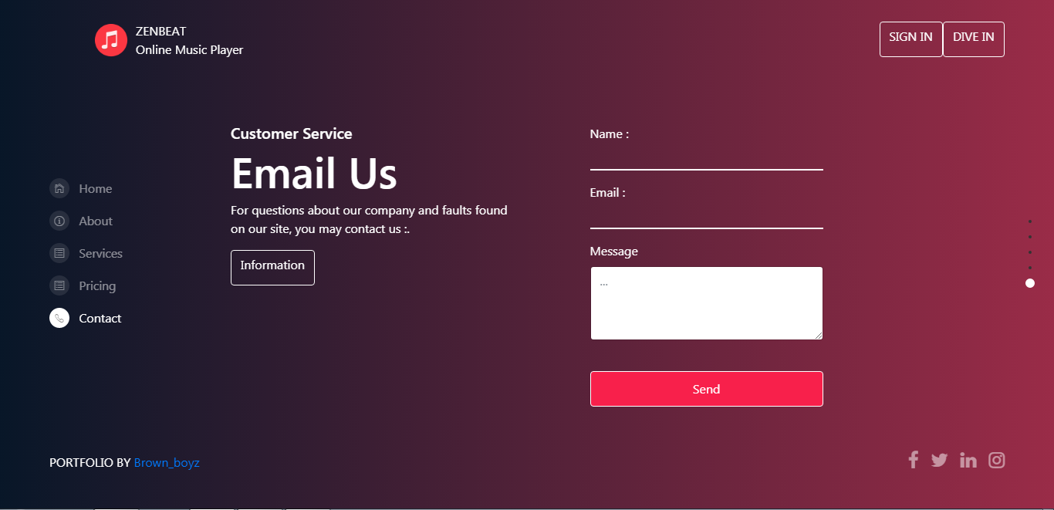
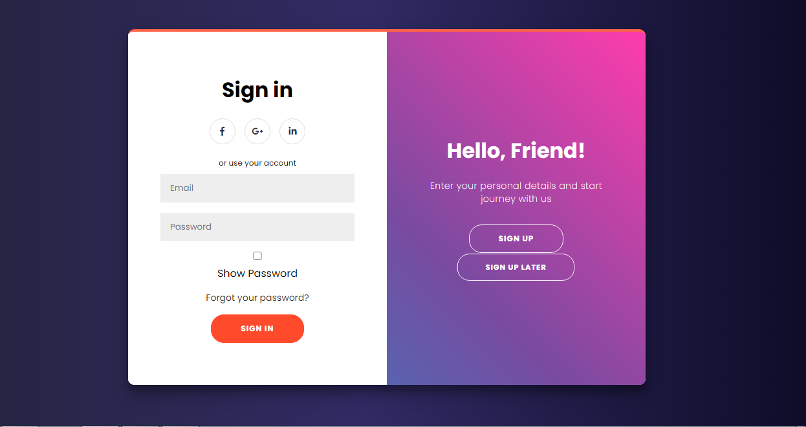
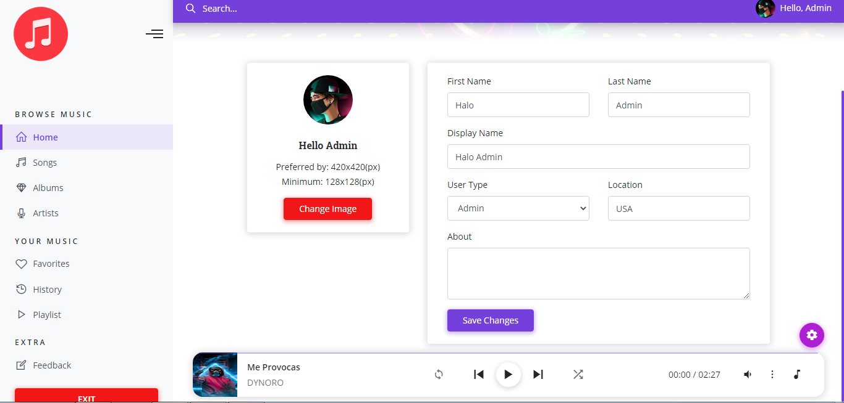
Extra Features
Custom Feedback Form
Sign In Later
User Dashboard/ Profile

Slide 13
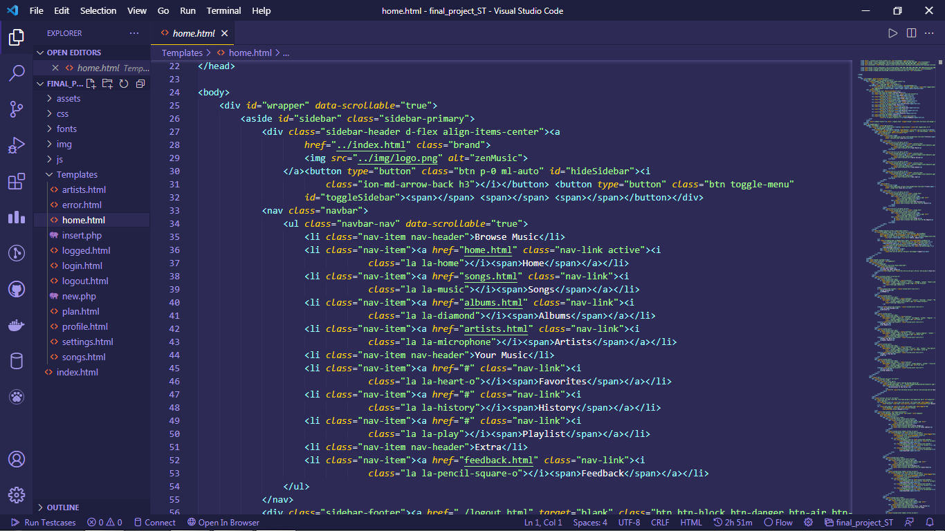
Some Code

Slide 14
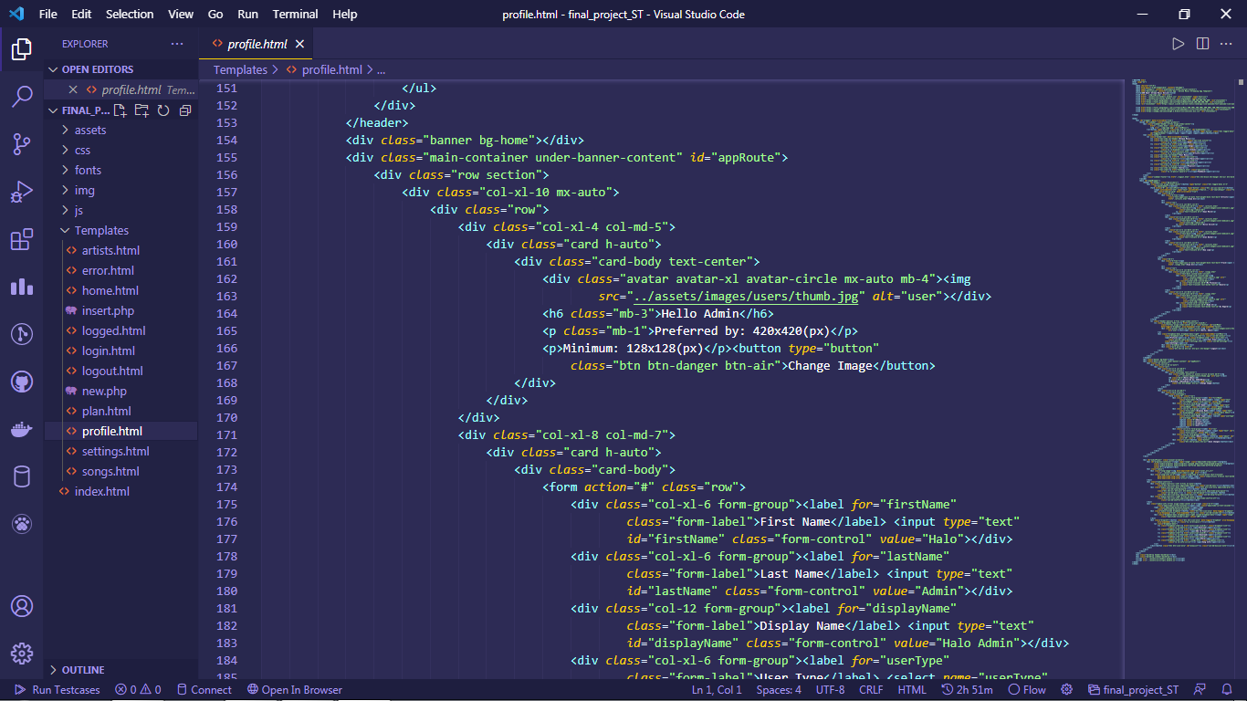
Some Code

Slide 15
03
Back End
Brief the Backend communication part followed in the website

Slide 16

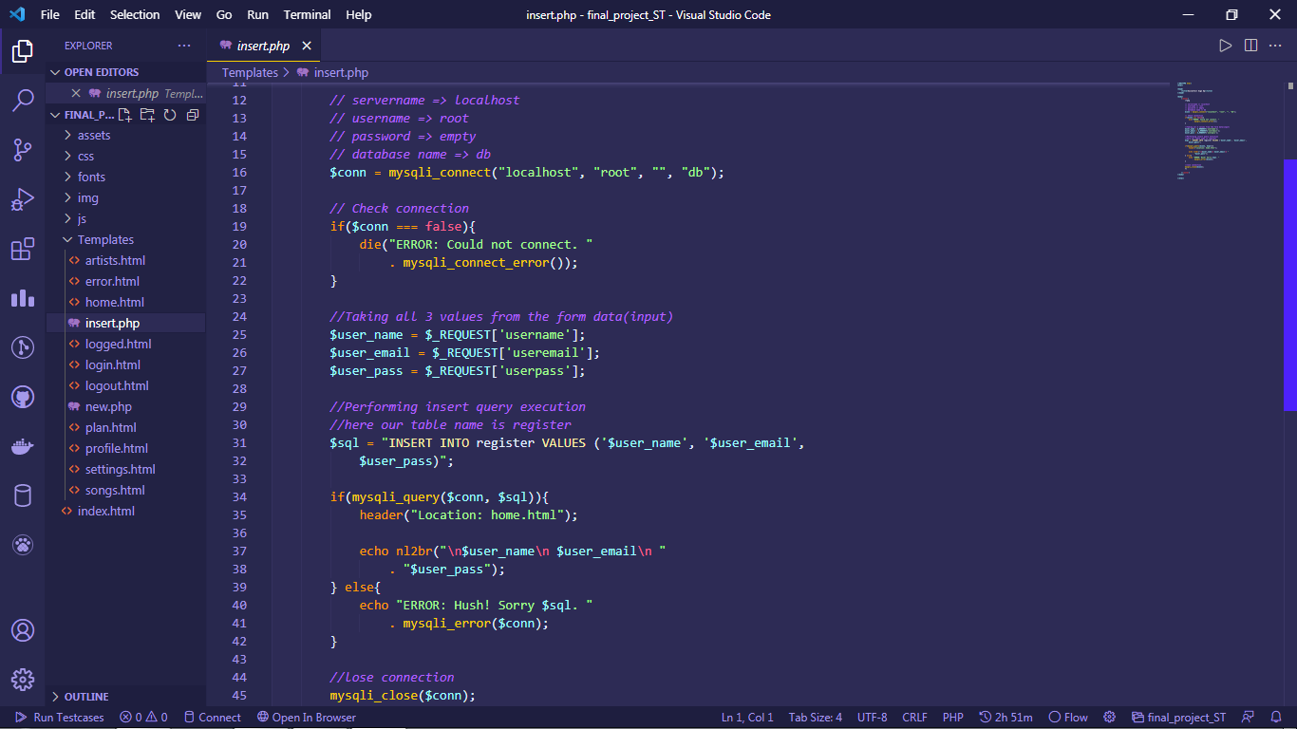
Backend with Php and mySQL
PHP
Connecting the user to database at the back end

Slide 17
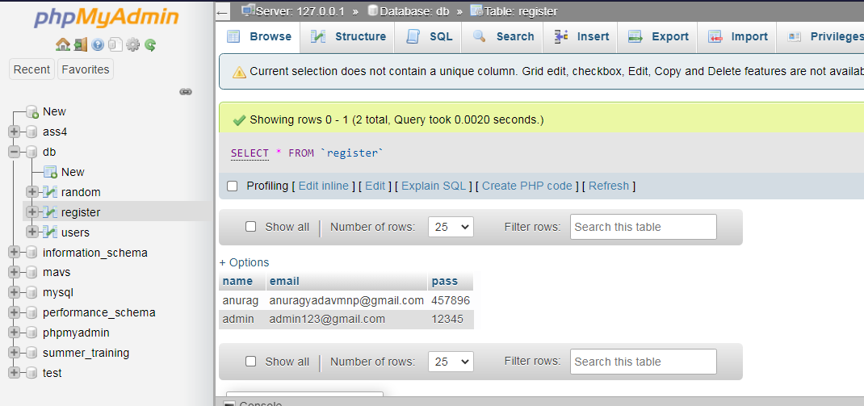
On successful insertion of data

Slide 18
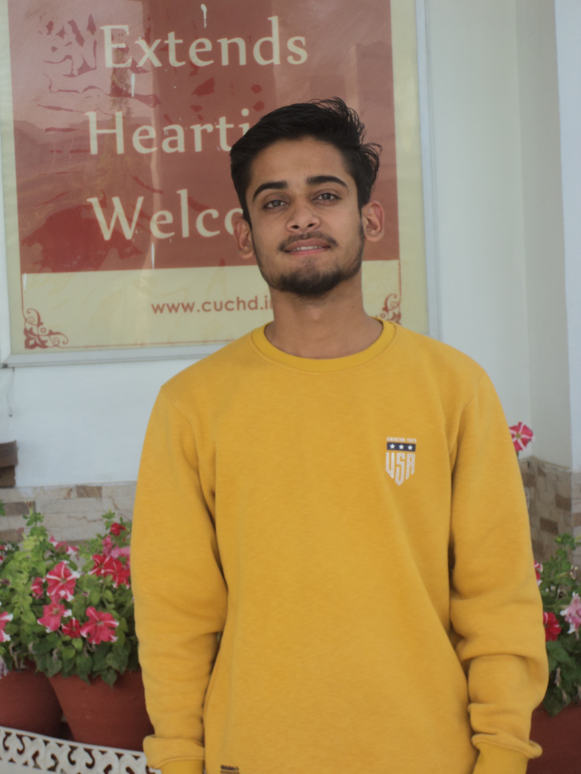
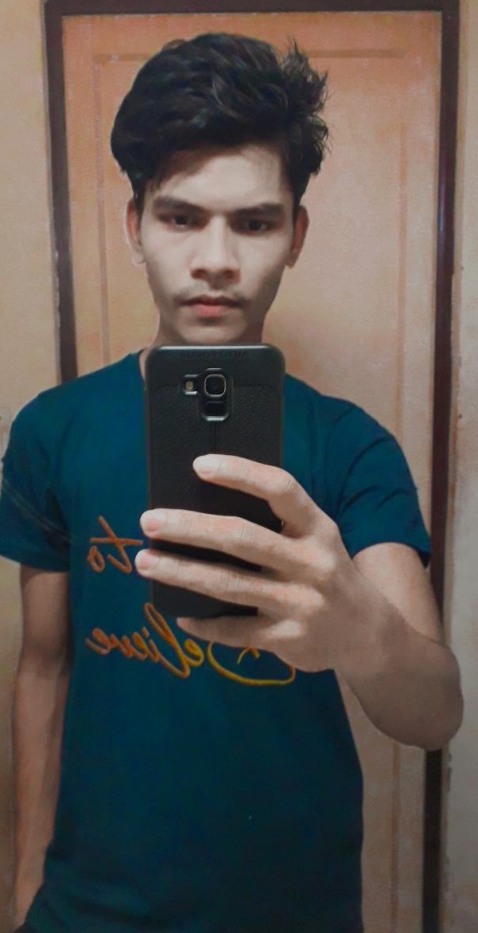
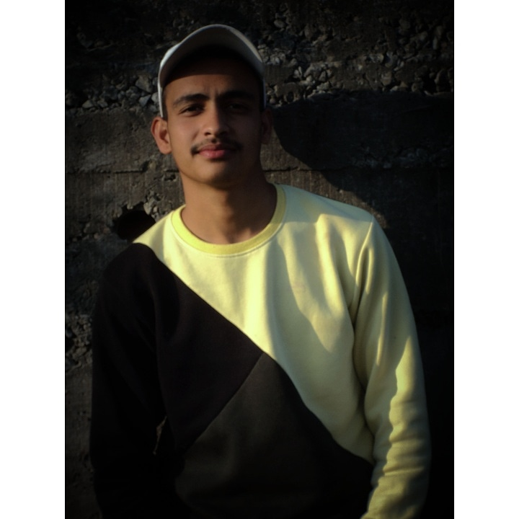
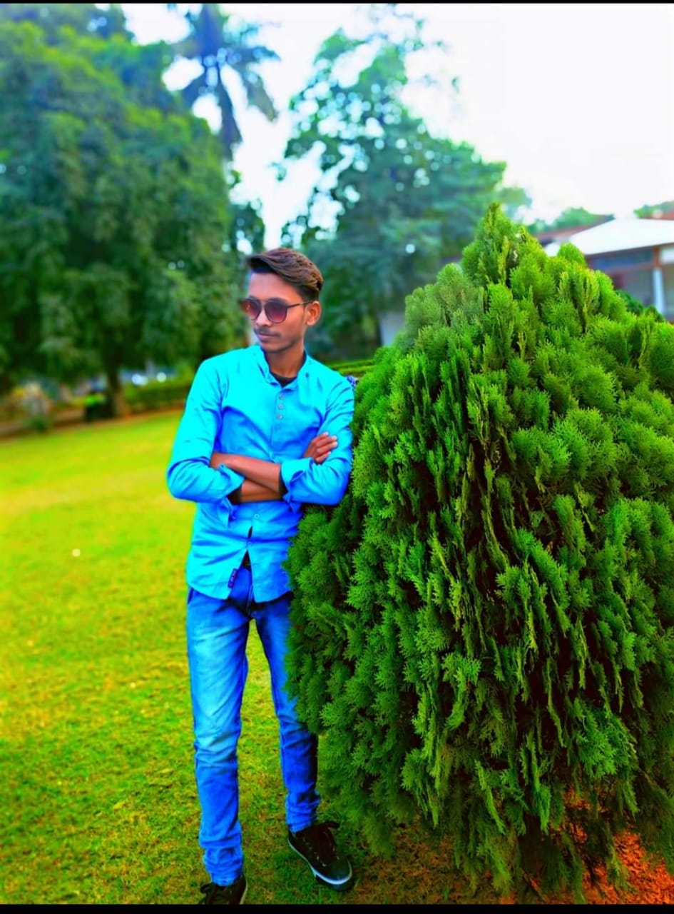
Meet the team
Abhishek Verma
20BCS5439
Anurag Yadav
20BCS5427
Kartik
20BCS5421
Deepak Kumar
20BCS5391

Slide 19
THANK YOU!

